Slide 1
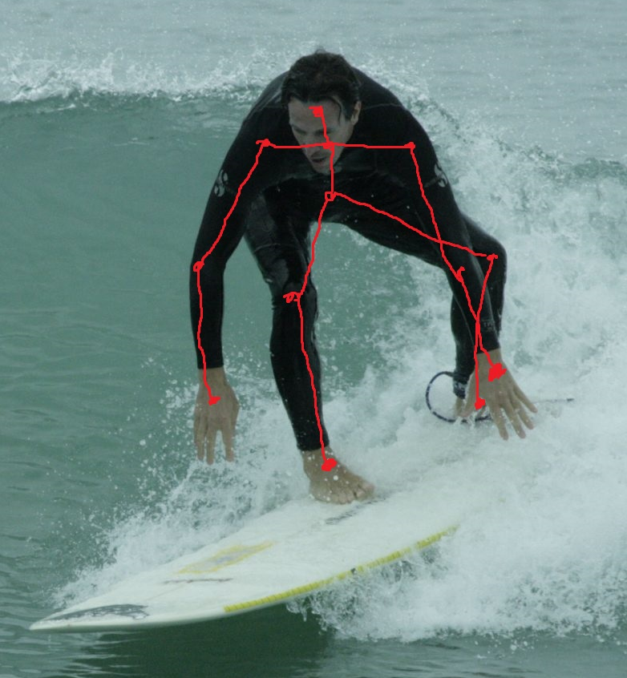
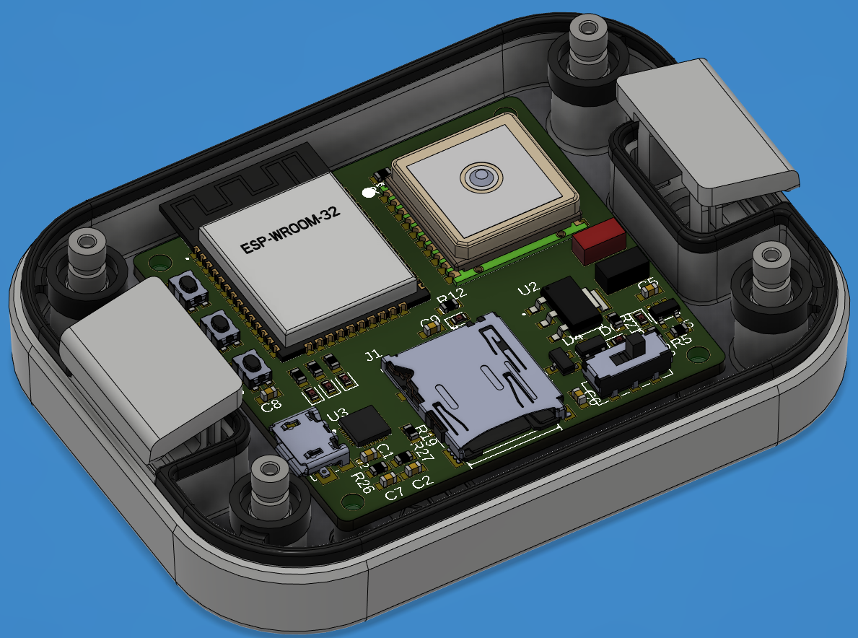

Time-Motion Analysis is a method of frame-by-frame video review that, when coupled with a proper scale, allows the motion of surfer to be recorded. A linear measurement scale also allows wave characteristics to be determined without additional instrumentation. Detailed TMA requires tracking multiple points of the body through the video and gives the relative motion of the surfer. This technique can be coupled with GPS/accelerometer/gyroscope data to give a complete picture of the surfer’s motion. However, these techniques are not well studied and have significant sources of error, particularly with larger scale events (like competitions) and sensor sampling rates and accuracy.
Published in the Journal of Strength and Conditioning Research, Performance Analysis of Surfing: A Review, summarizes the known research done on the forces experienced by a surfer as of January 2017 and discusses the validity of multiple measurement methods for surfer dynamics. The paper compiles information from many different papers on the measurements of external loads, time-motion analysis (TMA), global position system (GPS) analysis techniques, and the measurements of internal loads like heart rate.
Farley, Oliver R.L.^{1,2}; Abbiss, Chris R.¹; Sheppard, Jeremy M.^{1,2} Performance Analysis of Surfing: A Review, Journal of Strength and Conditioning Research: January 2017 - Volume 31 - Issue 1 - p 260-271 doi: 10.1519/JSC.0000000000001442
Instrumentation packages, like Thetis, and analysis techniques such as TMA can allow the complex motion of a surfer performing advanced techniques to be analyzed. Such analysis allows for a better understanding of the dynamic interaction between a floating body and a wave as well as the physiological demands on the surfer.
According the paper, there is little information available to coaches and surfers on key performance analytics
There have been no studies (as of January 2017) analyzing female surfer performance
There have only been four studies of surfers using the TMA technique
According to the paper, environmental variables are known to have an impact on surfer performance (duh), but have been uncharacterized in conjunction with surfer motion
There have only been four studies of surfers using GPS tracking
The Thetis instrumentation package is designed to record over 15 motion parameters from an on-board Inertial Measurement Unit, and record GPS location, course, and speed while fitting within the footprint of a credit card

